Slide 1

AI Expense Tracker — Smart Financial Management
Team members:
1. Nem Sothea
2. Suon Pisey
3. Sourn Savourn
4. Oun Sreynich

Slide 2
Content
Introduction
Expense Tracker Mobile App
Process Flow — Mobile App
Expense Tracker Web Application
Process Flow — Web Application
Key Features
Benefits & Impact
Demo

Slide 3

1) Introduction
Managing daily expenses is tough. That's why we built the AI Expense Tracker—a mobile and web app that uses AI to help you easily record, track, and analyze your spending.

Slide 4



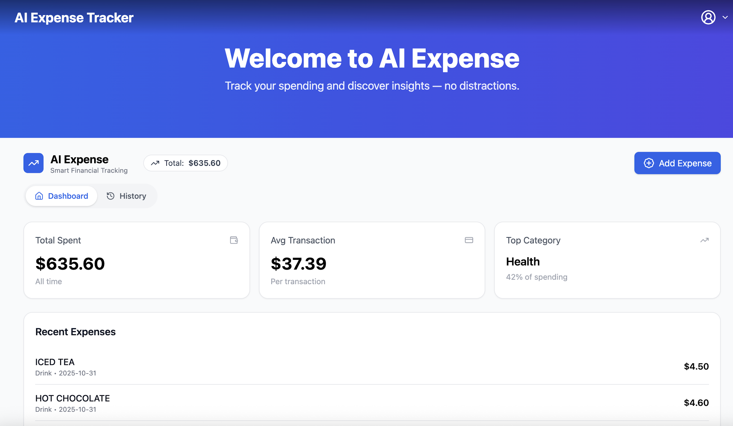
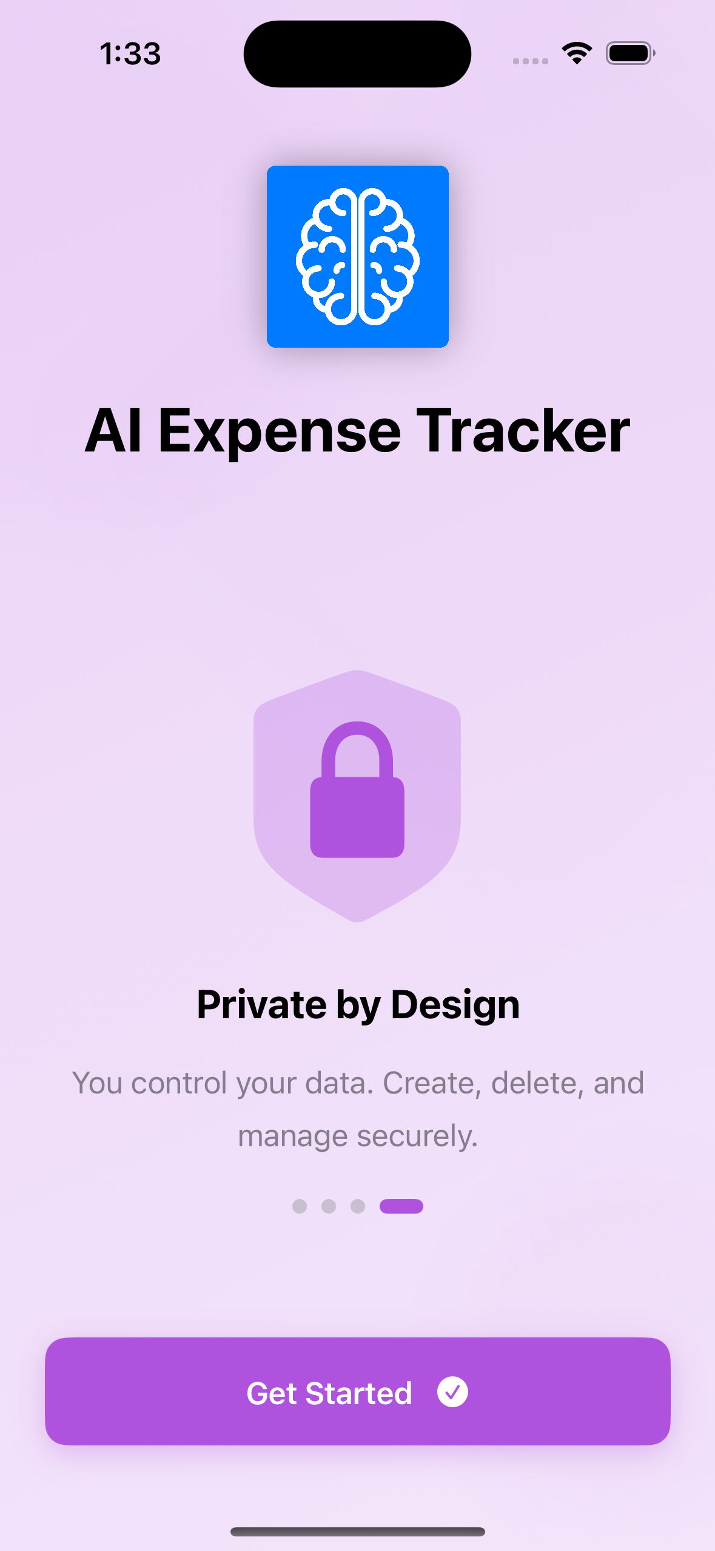
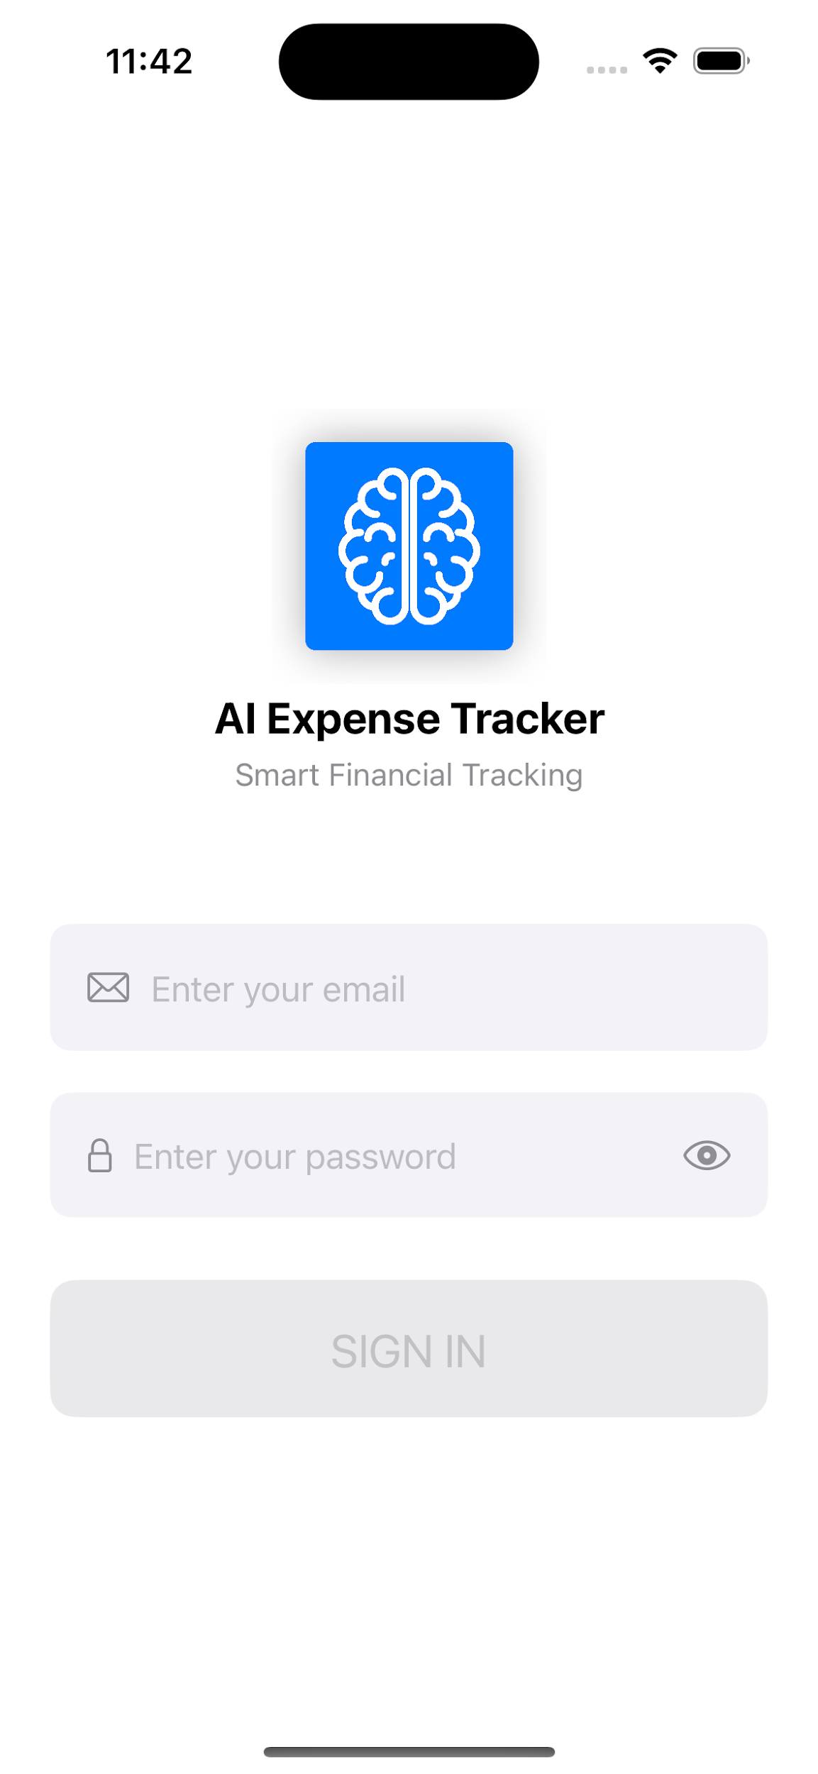

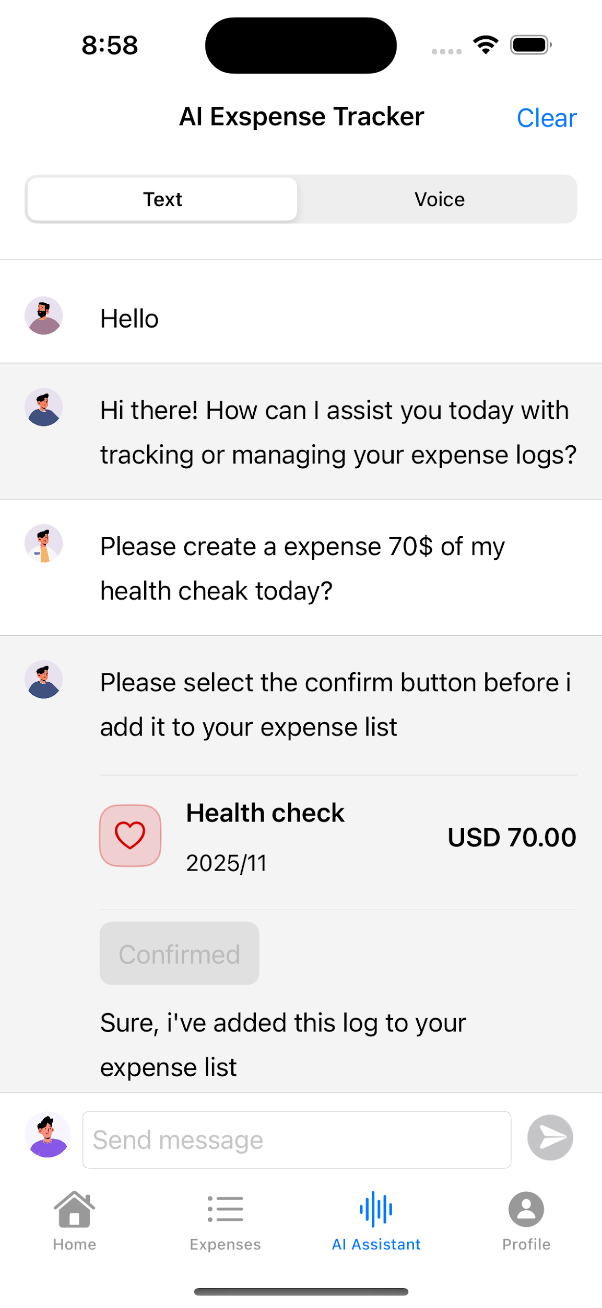
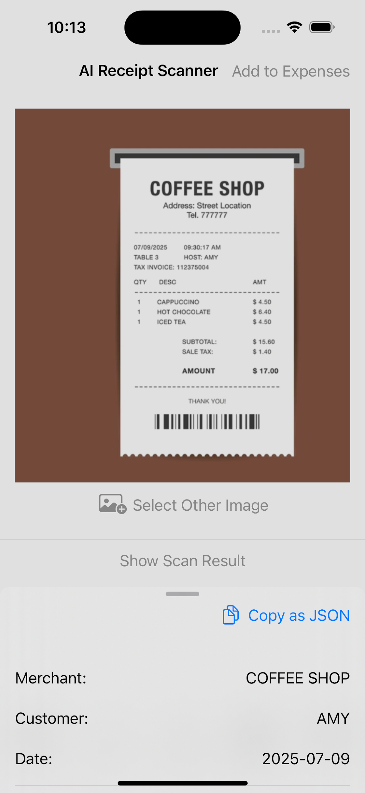
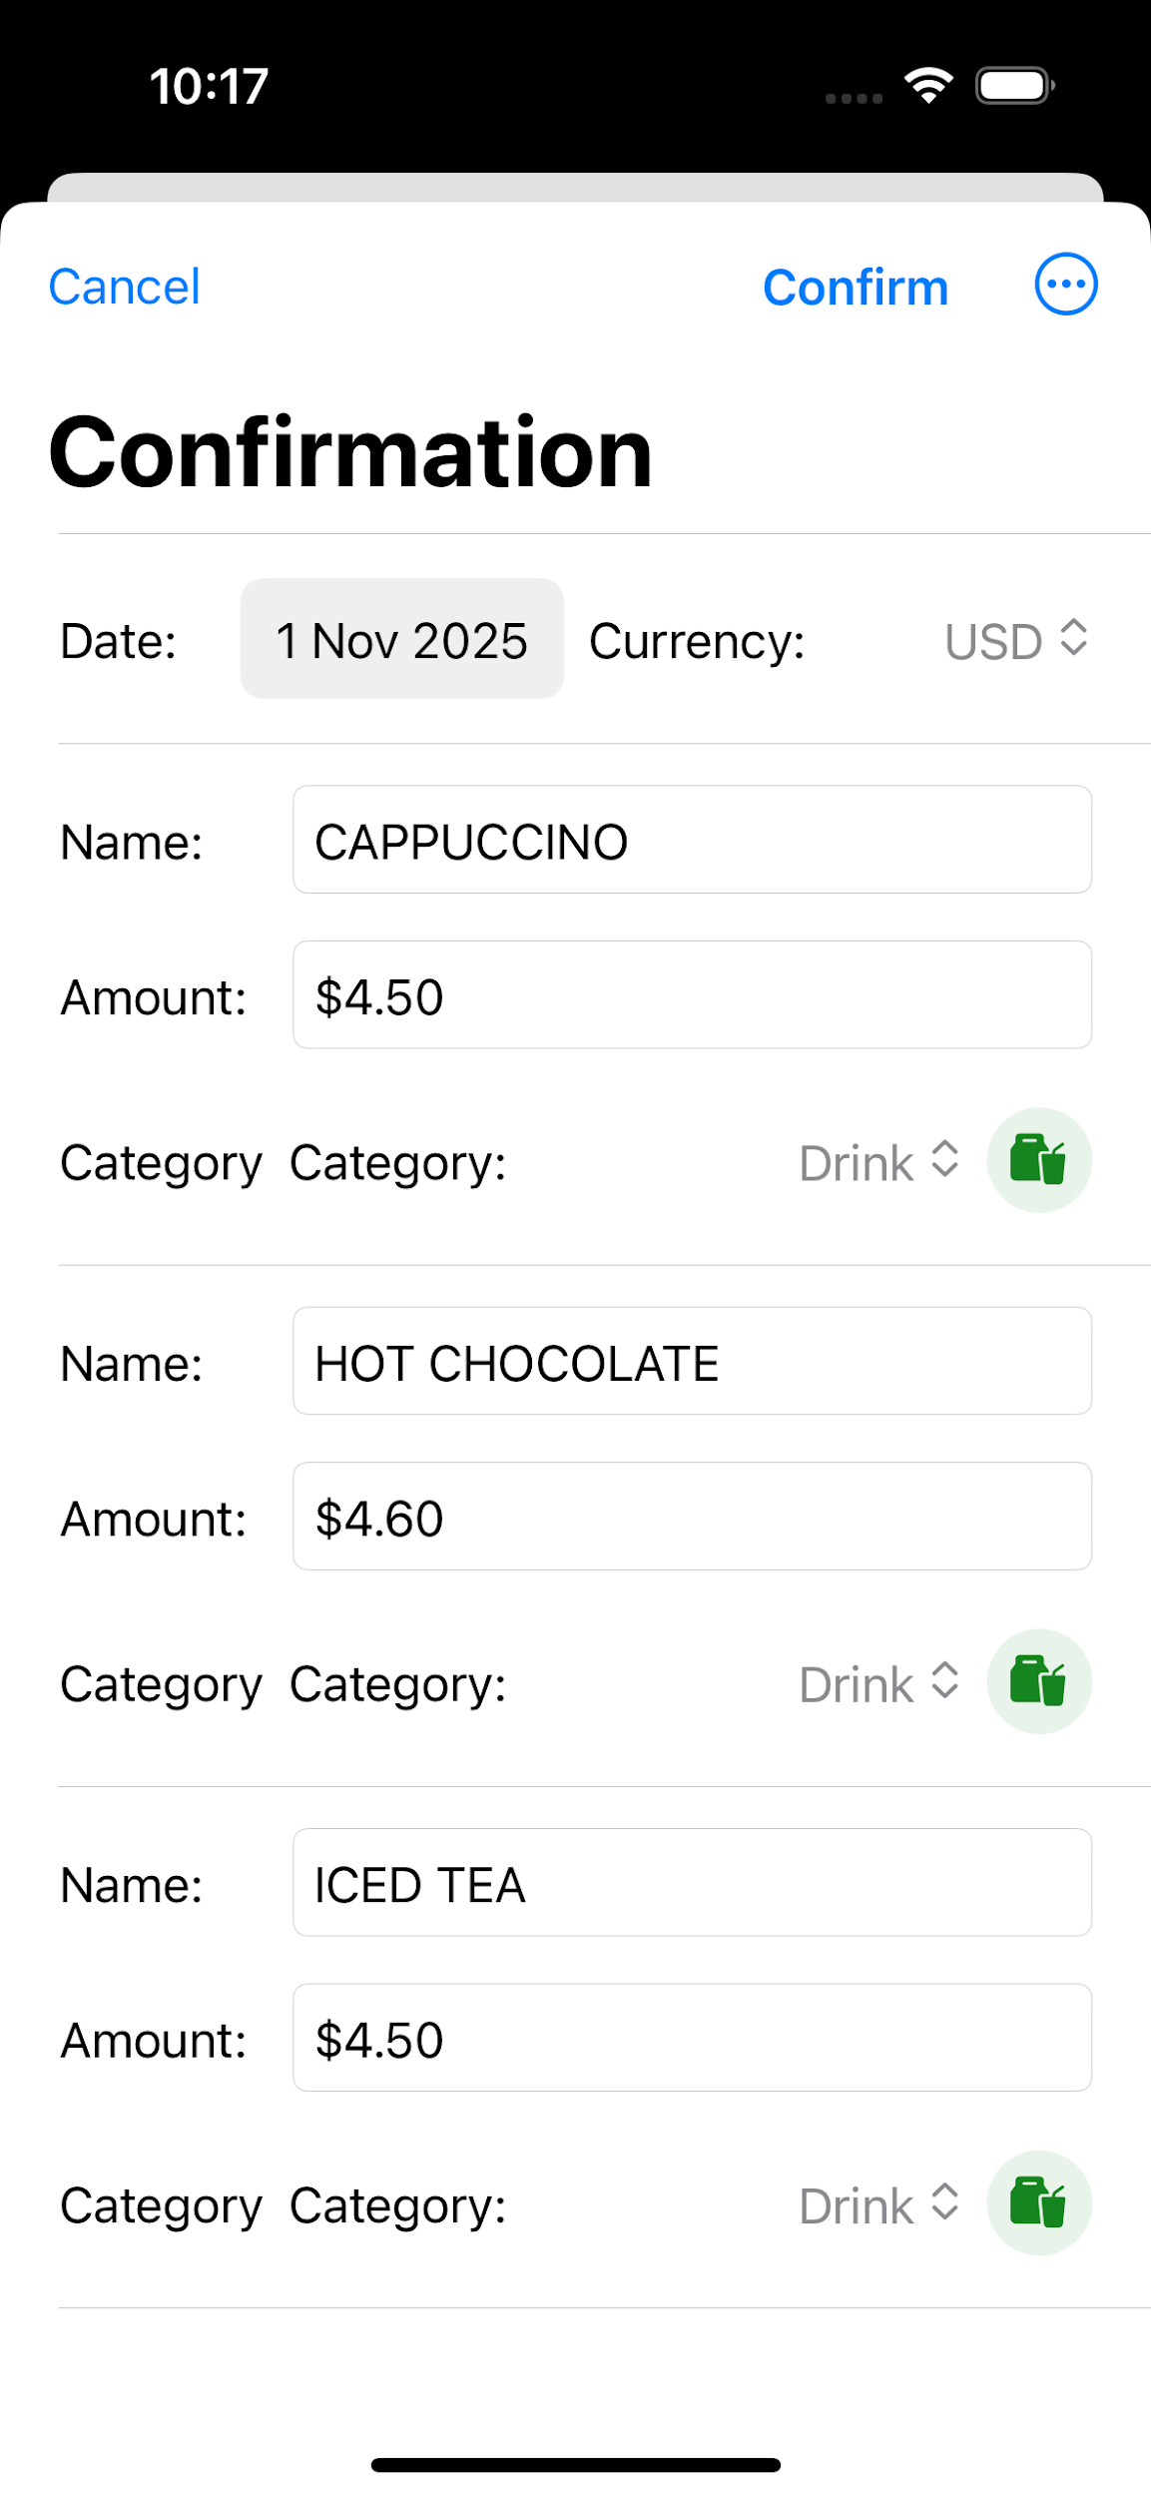
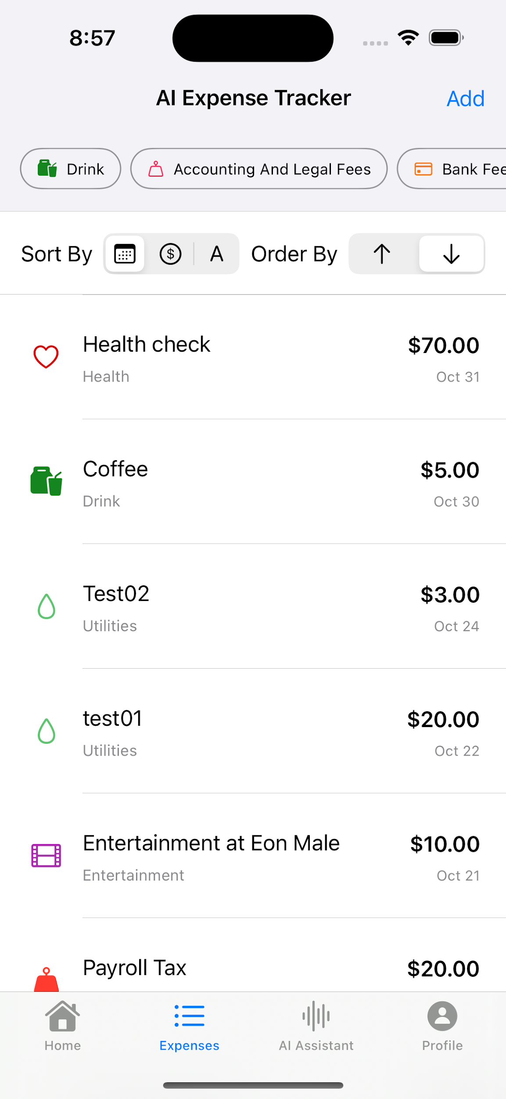
Say Hello to Financial Freedom
AI Expense Tracker — Smart Financial Management
AI Expense Tracker — Smart Financial Management

Slide 5
2) Expense Tracker Mobile App
On mobile, users can quickly launch the AI Expense app and log in with their email. Once logged in, the main screen displays a summary of expenses. From there, users can add new expenses and view their expense history.

Slide 6
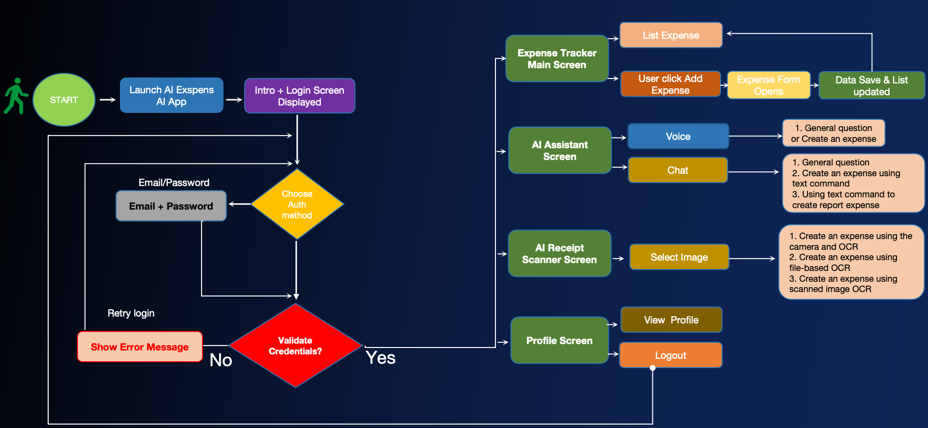
3) Process Flow — Mobile App(Normal diagram)

Slide 7
3) Process Flow — Mobile App(Normal detail)
The user opens the app.
Login using email and password.
Once validated, they land on the Expense Tracker Main Screen.
They can tap ‘Add Expense’ to open the form.
After saving, the data automatically updates in the list view.

Slide 8
3) Process Flow — Mobile App(AI Detail)
Moreover, they can tap ‘AI Assistant’ to open the form.
They can ask general questions or create an expense after confirmation, the data automatically updates in the list view.
On the other hand, they can tap ‘Receipt Scanner’ to open the form.
They can scan the receipt to create an expense after confirmation, the data automatically updates in the list view.
Users can also manage their profile and log out anytime.

Slide 9
4) Expense Tracker Web Application
The web app version focuses on giving users a clear financial overview through a dashboard — perfect for reviewing spending habits and analyzing financial patterns.

Slide 10
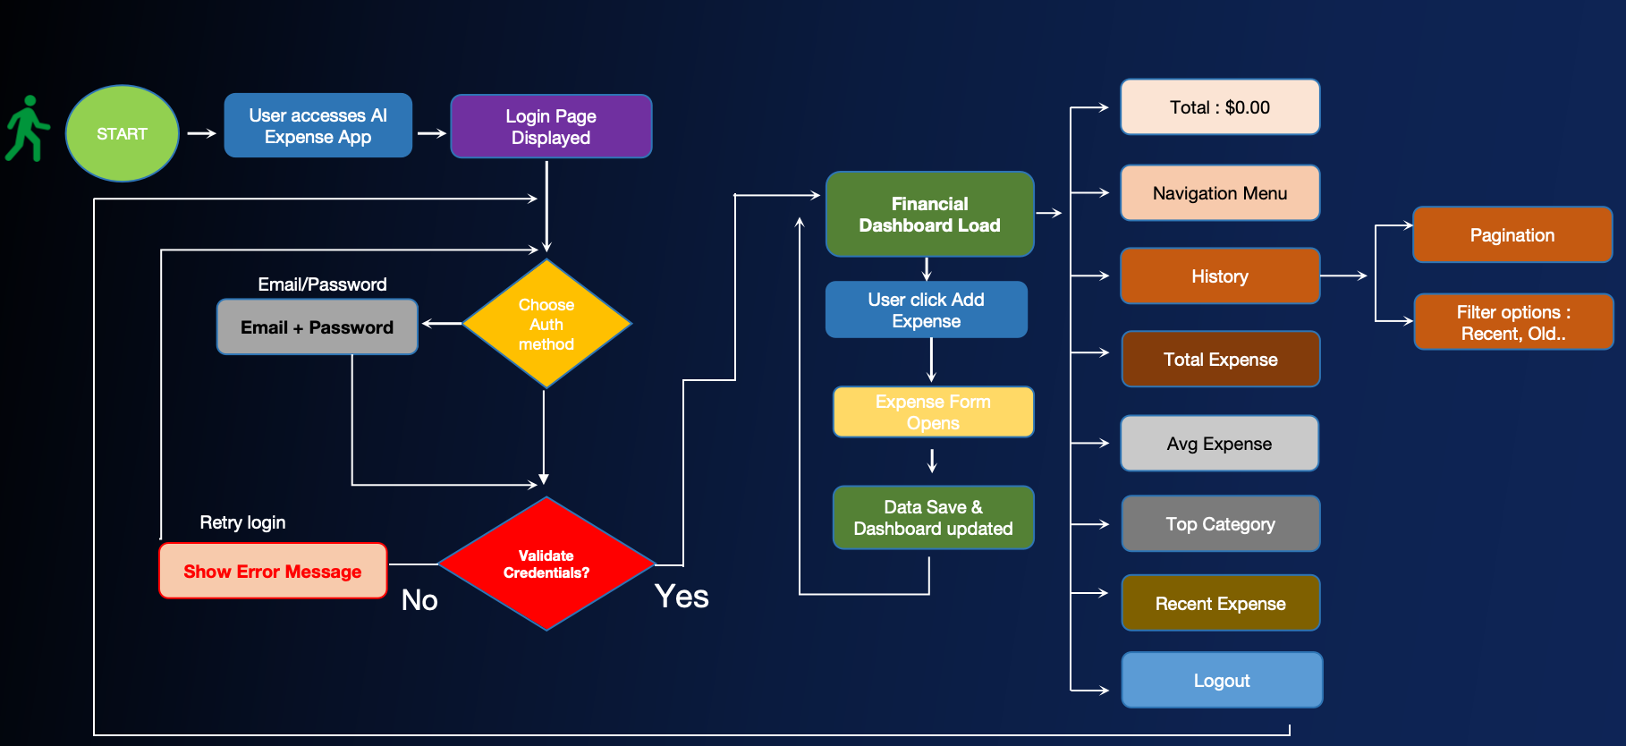
5) Process Flow — Web Application(diagram)

Slide 11
5) Process Flow — Web Application
The user accesses the AI Expense web app and logs in via email or register for new user.
Once validated, the Financial Dashboard loads.
From there, users can click ‘Add Expense’ to open the form and input new data.
When saved, the dashboard automatically updates key financial metrics.
Within the History tab, users can filter, search, update, and delete.

Slide 12
5) Process Flow — Web Application(continue)
Navigation options include:
Total Expense
Average Expense
Top Category
Recent Expense
Expense History
Logout

Slide 13
6) Key Features
Useful Functions Across Platforms
Add & Manage Expenses — Quick input form for daily spending.
Expense Dashboard (Web) — Visual summaries and categories.
Expense List (Mobile) — View and update expenses easily.
AI Assistant(Mobile) — ask general questions and create an expenses easily.
Receipt Scanner(Mobile) — scan receipts and create an expenses easily.
Profile Management — Update personal details anytime.
Cross-Platform Sync — Data stays consistent between web and mobile.

Slide 14
7) Benefits & Impact(Key Benefits)
✅ Save Time : From minutes to seconds. No more manual entry.
✅ Perfect Accuracy : AI auto-categorizes everything correctly.
✅ Stay on Budget : Get smart alerts before you overspend.
✅ Total Control : See your finances clearly and make confident decisions.

Slide 15
7) Benefits & Impact(Key Impact)
Before SmartSpend | After SmartSpend
A stressful routine task | An easy habit
Guessing & confusion | Confidence & control
Wondering where money went | Knowing where your money is going
**We turn financial stress into financial freedom.

Slide 16
Mobile UI
Spring boot backend(PostgreSQL Database), React Web Application , Mobile(SwiftUI)

Slide 17
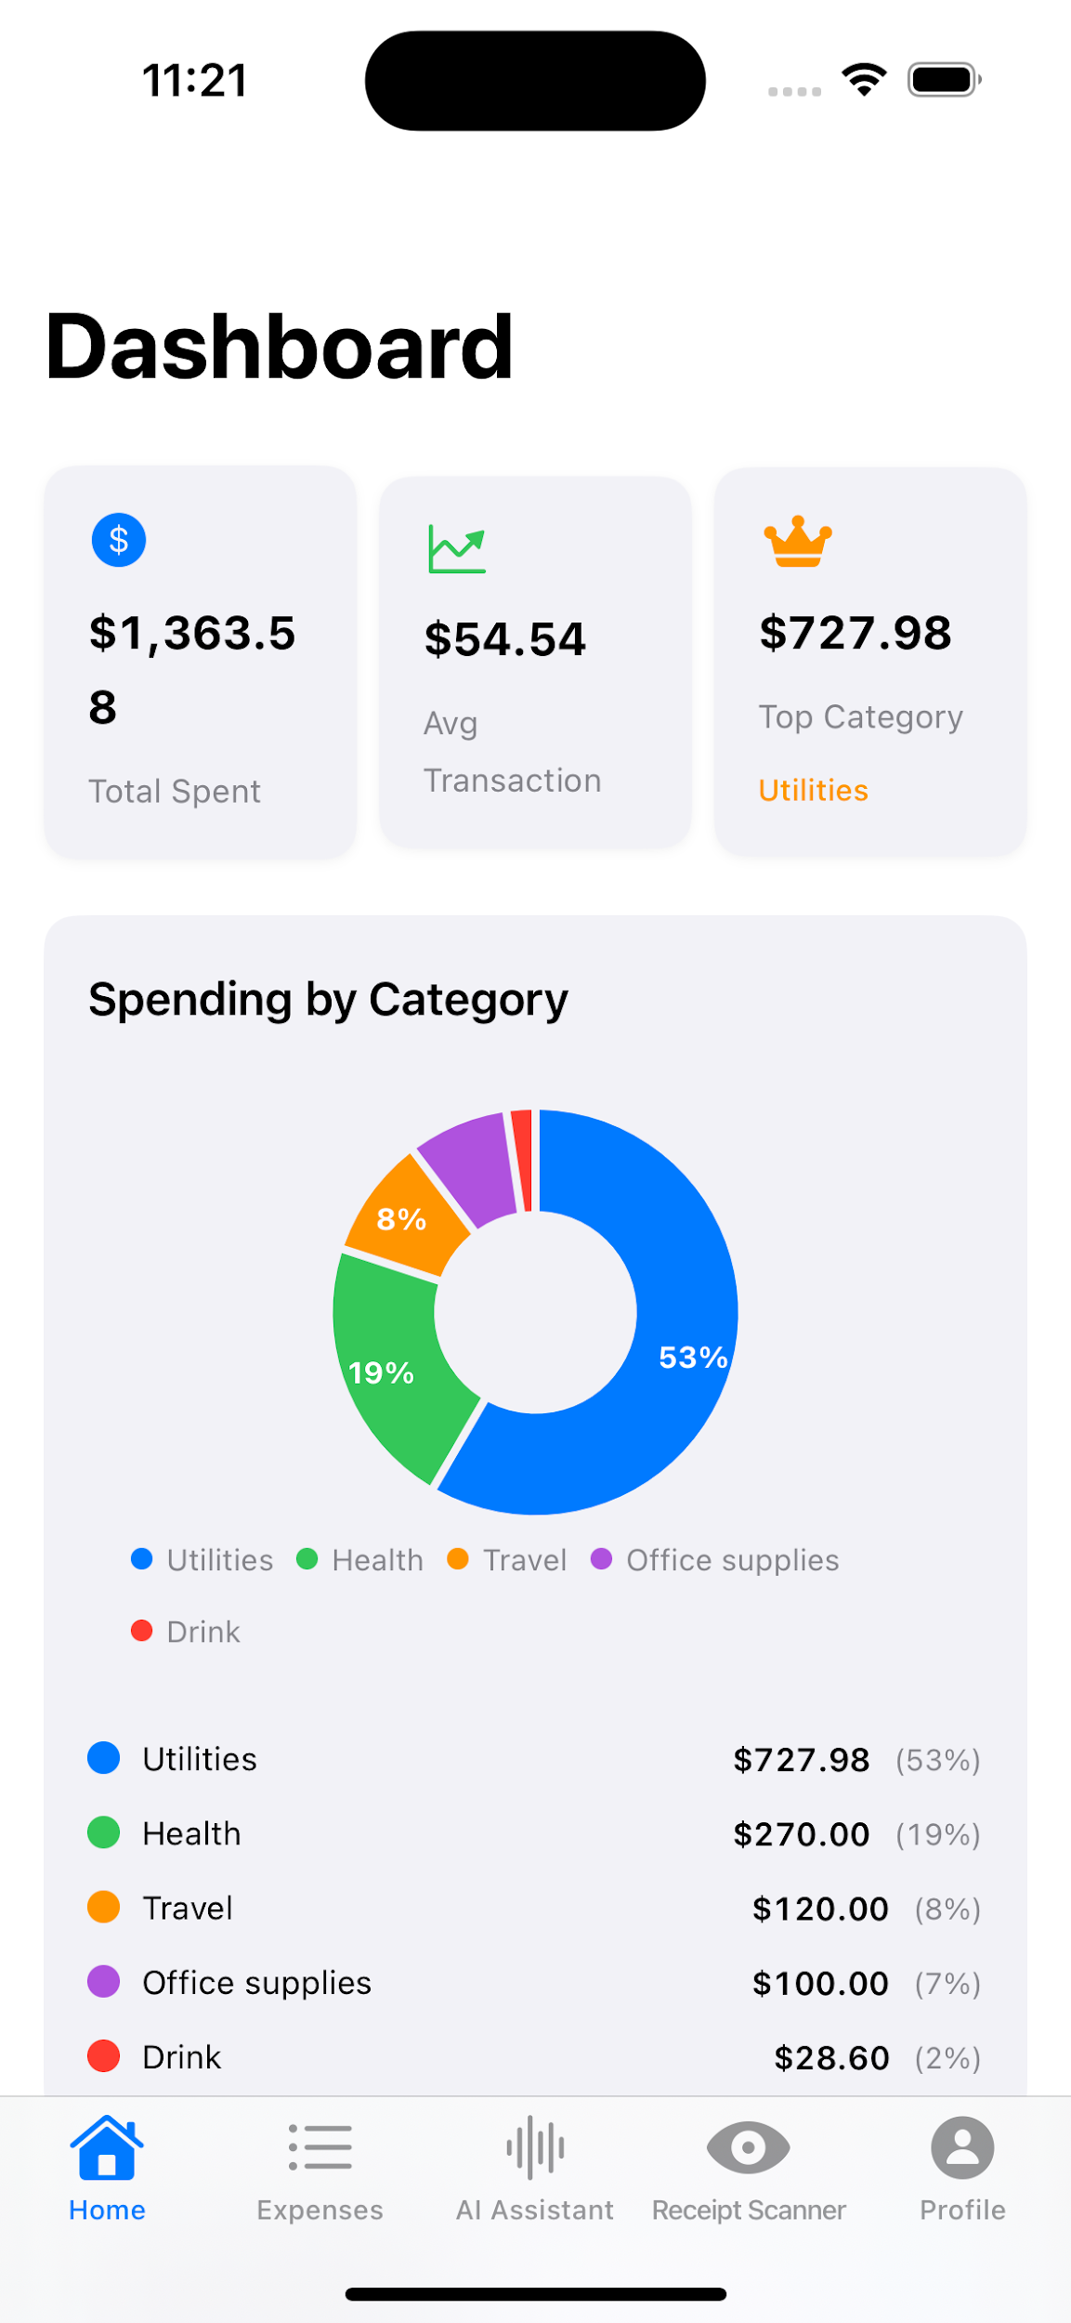
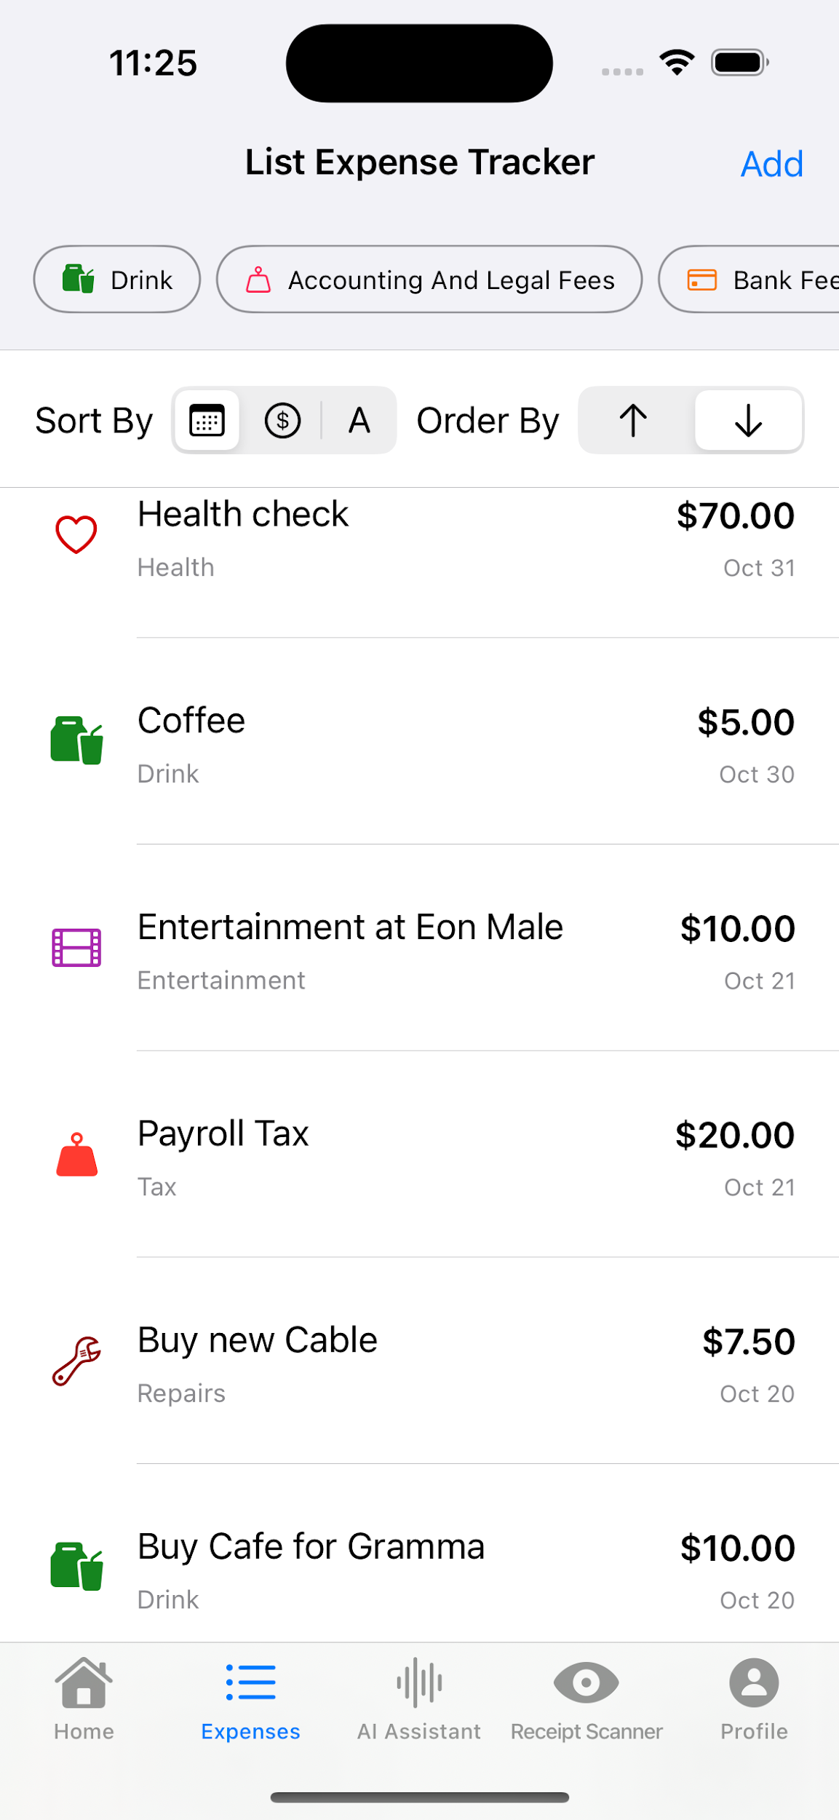
Mobile UI

Slide 18
Mobile UI + AI

Slide 19
Web UI
Spring boot backend(PostgreSQL Database), React Web Application , Mobile(SwiftUI)

Slide 20
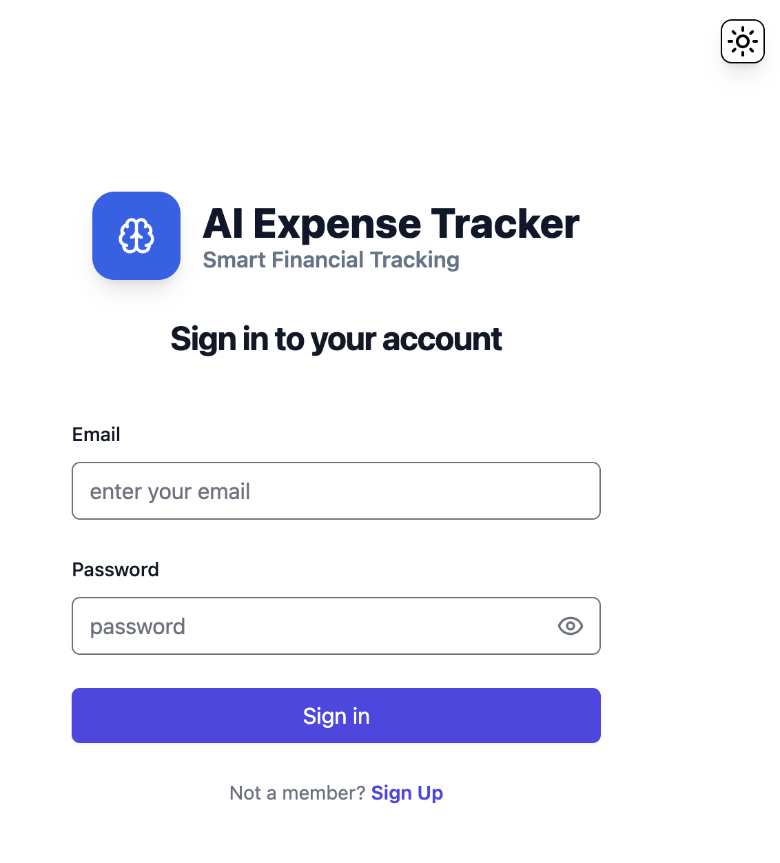
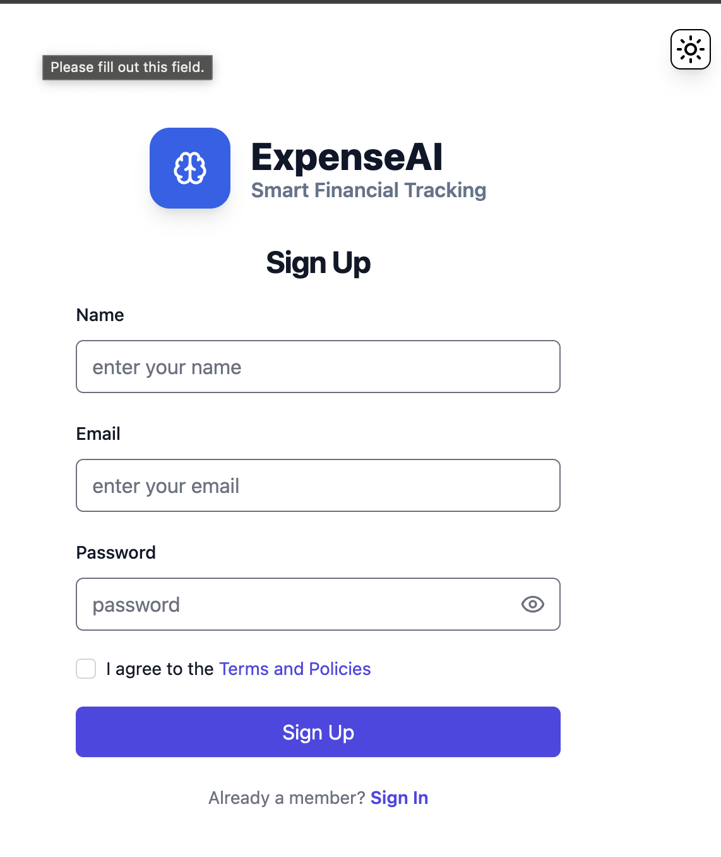
Web UI

Slide 21
Web UI + Dashboard

Slide 22
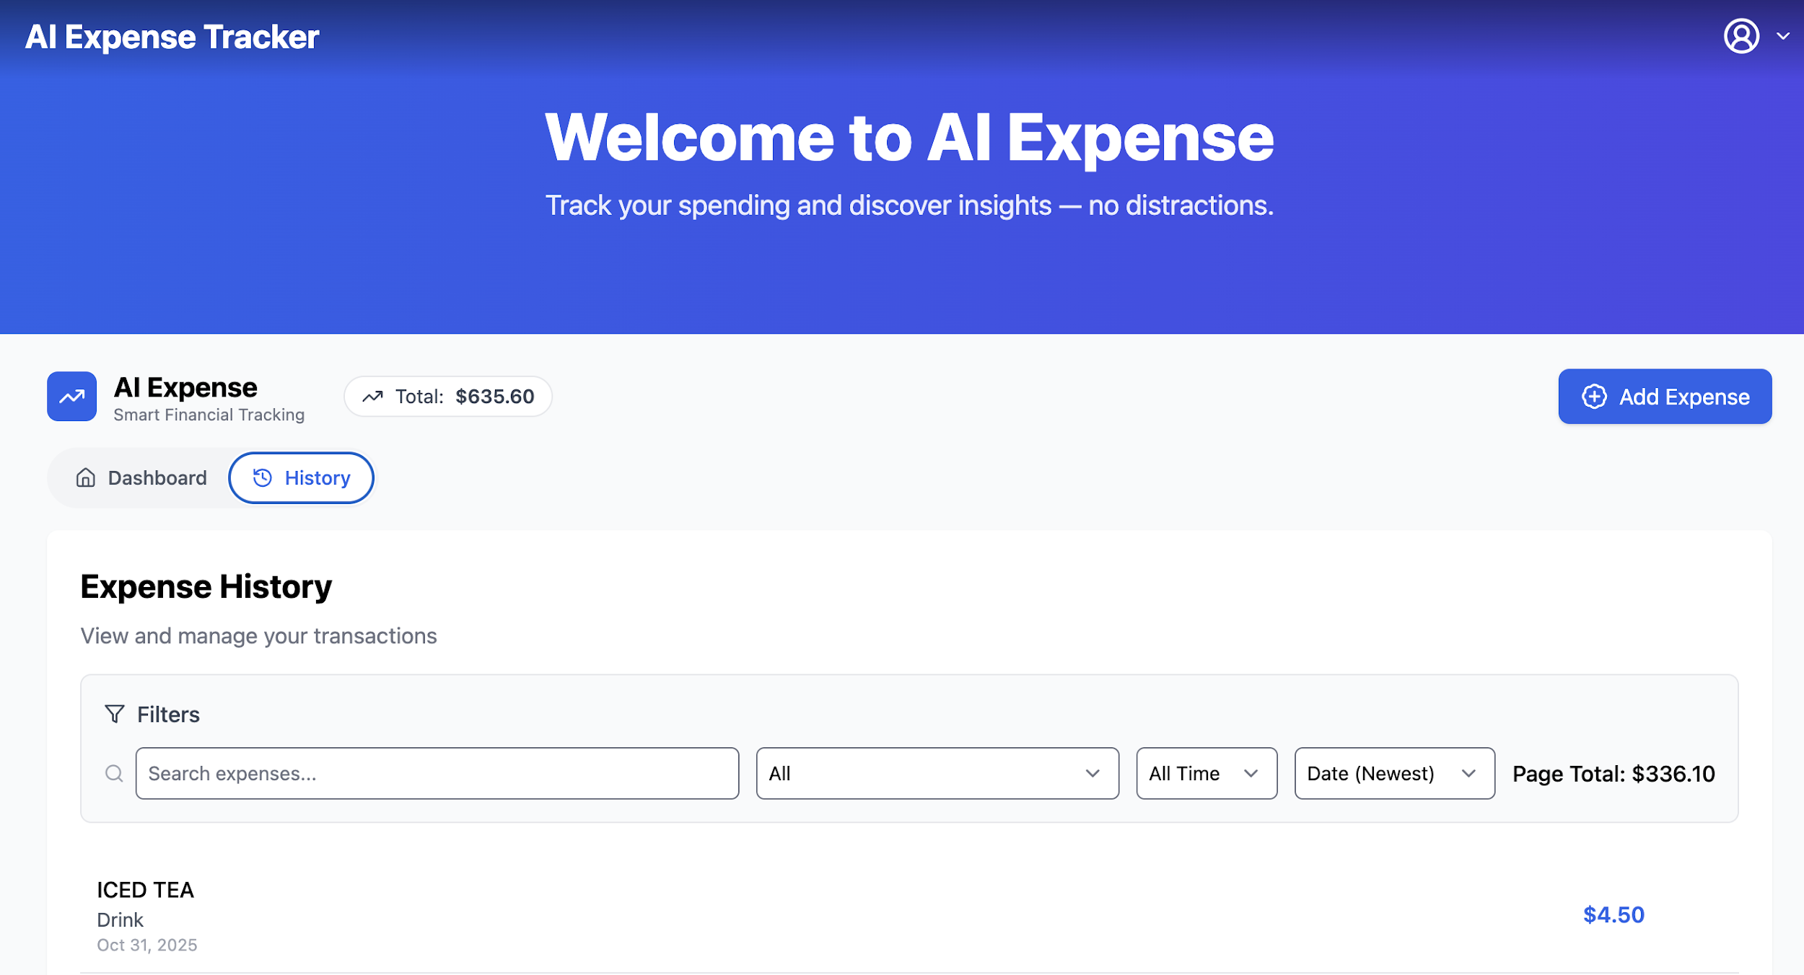
Web UI + History

Slide 23
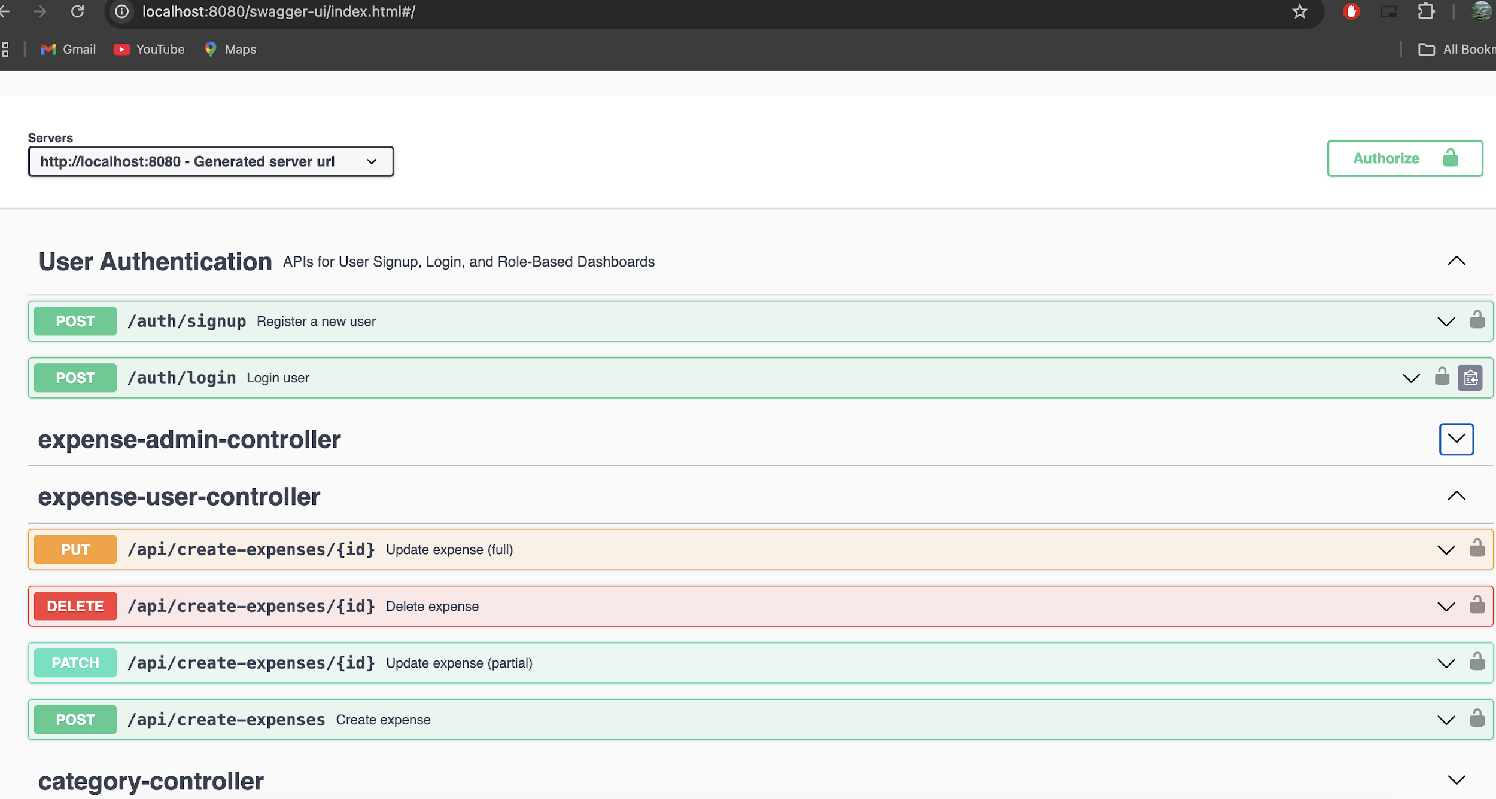
Spring Boot Back-End(PostgreSQL)

Slide 24
Demo
Spring boot backend(PostgreSQL Database), React Web Application , Mobile(SwiftUI)

Slide 25
Thank you!
Q&A?
Notes:
Thank you for your attention. This project reflects my goal to make personal finance management smarter, simpler, and more accessible for everyone.

